Slide 1

Pocket Tanks
Project by:
Aum Patel
Meet Patel
Manush Thaker
Karan Adhaduk

Slide 2

Introduction
The game for understanding AI agents.
Game starts with two tanks, where one of the tanks fires on their target of another tank to smash them with fireball.
There is a wall created in between of the two tanks to make the game more challenging.
Winds affects the resistance for the fireball to travel further distance.

Slide 3
Why is this important
The part of the project that was fascinating the most was how details were picked in this game like wind affects the power of the fireballs.
Another detail in this game is how ball is disappeared in the display map does not go through it.
The wall feature in this game allows for the wind to flow through it sometimes depends on the selection made by the user.
This a good example to AI agent working in different conditions producing different outcomes every time referring to the situation.

Slide 4
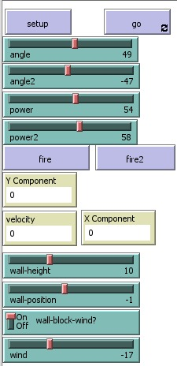
Parameters
Angle and Angle 2
Power and Power 2
Fire and Fire 2
Wall height
Wall Position
Wall block Wind
Wind

Slide 5

How the code works
Code is created by mainly two processes i.e., setup and go.
Furthermore, as we move forward the shape, sizes, colors and the position with respect to origin is set for both tanks.
When the fireball is shot from the tank, the live origins of x and y along with velocity is displayed.
The code prompts the fireball to die as soon as it is reached in the boundaries of the map.
All the parameters will reset once the setup is pressed by user.

Slide 6
Working of Model
Angle and Angle 2 are slider used to set the angle of Tank 1 and Tank 2 respectively.
Power and Power 2 are also a slider used to set the power at which the Tank 1 and Tank 2 will fire the ball in projectile motion.
Fire and Fire 2 and button which when pressed will shoot the ball projectile from Tank 1 and Tank 2 respectively.
Wall height is again a slider which will adjust the height of wall(obstacle) present in between the two tanks.

Slide 7
Working of Model(Contd.)
Wall position is also a slider used to move the wall(obstacle) along the X-axis
Wall block wind is an on/off switch which tells whether the wall will block the wind or not.
Wind is again a slider that will tell whether the wind is in the direction of Tank 1 or Tank 2 and how much will it affect the ball’s projectile motion.

Slide 8
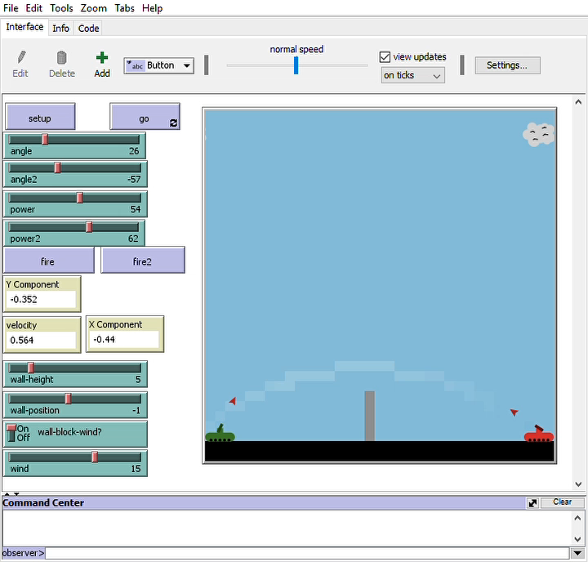
Simulation

Slide 9


Conclusion
Importance
Parameters and algorithm explanation
Model Working with Simulation

Slide 10


THANK YOU

